Slide 1
Online portfolio shreyash.girade prn- 25070521171 class-c/c2

Slide 2
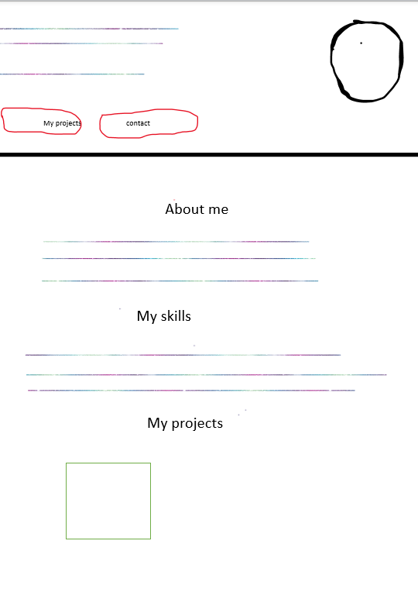
Basic structure of portfolio
Image
Small information
Background will blue
My contact

Slide 3
Languages used
- I have used HTML and CSS language in coding.
- HTML (HyperText Markup Language) and CSS (Cascading Style Sheets)
are the foundational languages for building web pages, working in tandem
to define the structure and presentation of web content, respectively.
Purpose-
HTML provides the structure and content for a webpage, defining elements like headings, paragraphs, and images.
CSS controls the presentation, styling, and layout of those HTML elements, managing aspects such as colors, fonts, and positioning.

Slide 4
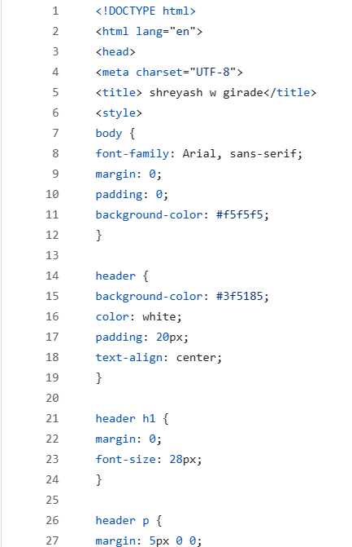
code
The portfolio made on notepad.
Take help from Github.

Slide 5
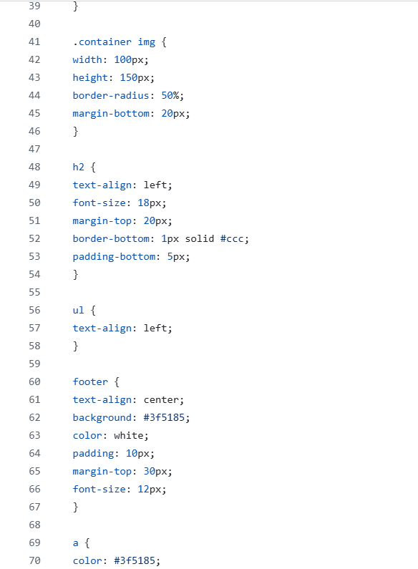
Css code
- I have done some
modification in this code.

Slide 6
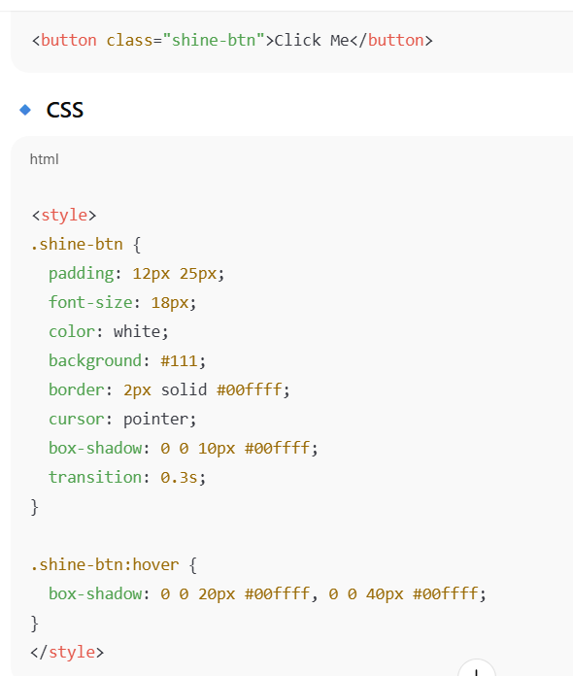
Shining text code
Take help from chatgpt

Slide 7
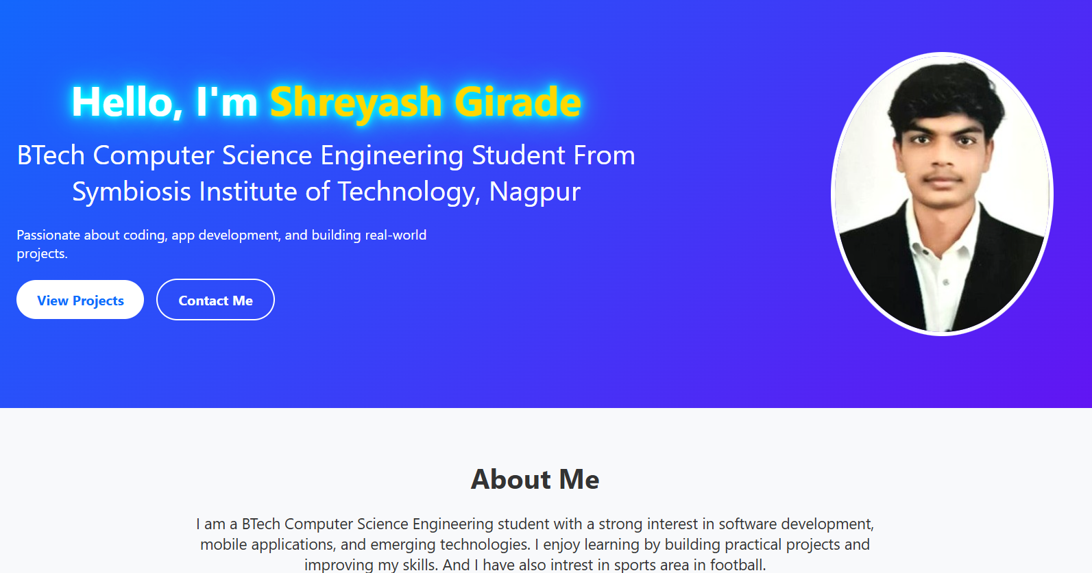
Portfolio

Slide 8
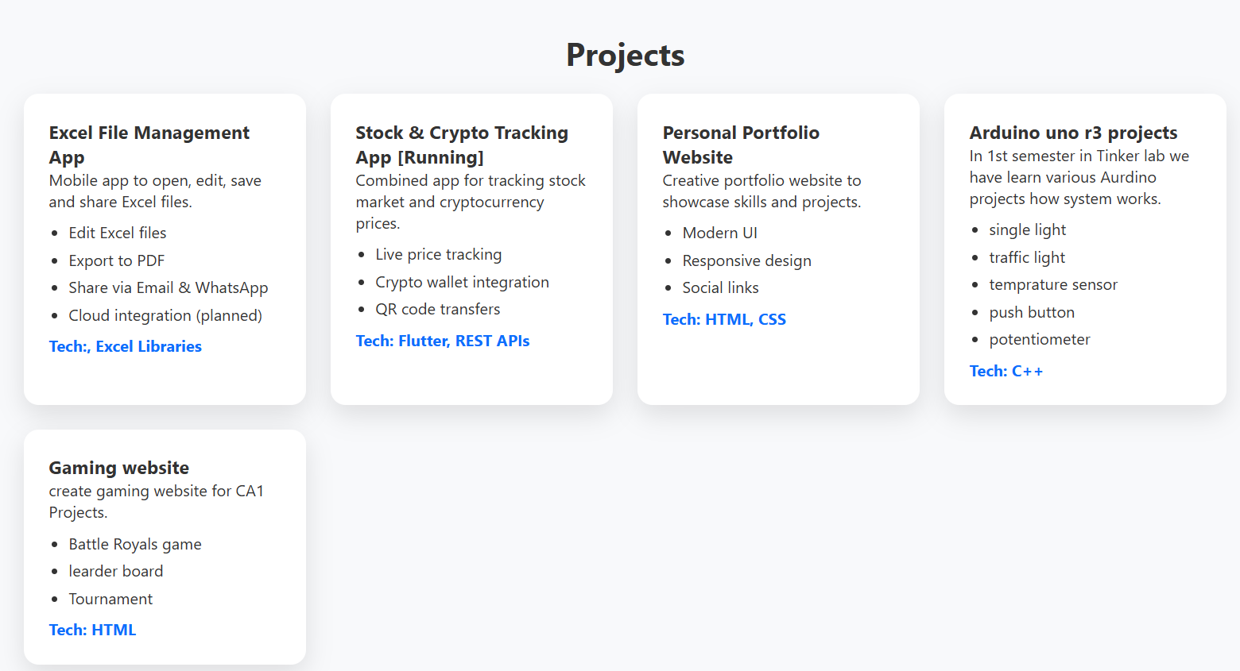
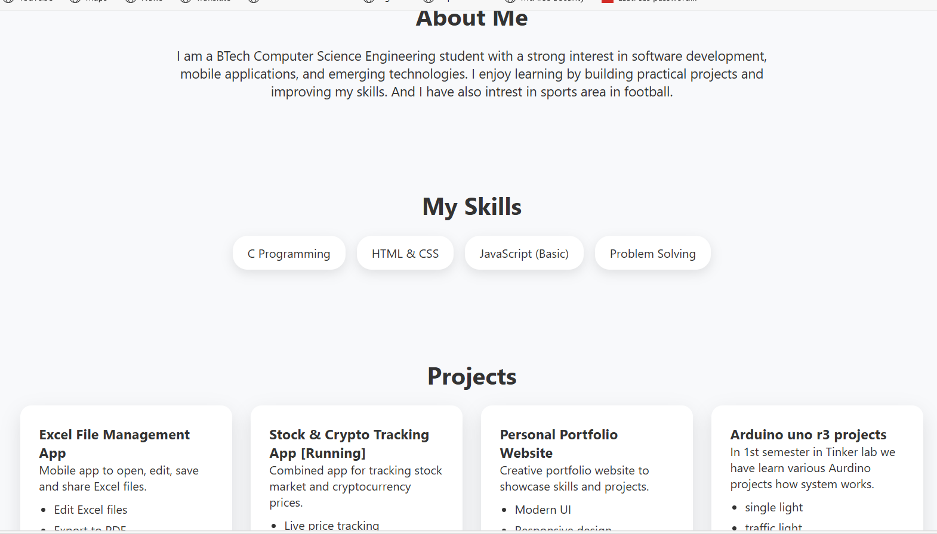

Slide 9
Thank you
Shreyash girade
PRN- 25070521171
7887479398
Shreyash.girade.batch@sitnagpur.siu.edu.in

